Slide 1
DataLens Automated Data Analysis Tool
CAPSTONE PROJECT
Presented By:
1.Rayhen Prakkash C.T (karunya institute of technology & sciences ) Computer Engineering

Slide 2
OUTLINE
Problem Statement (Should not include solution)
Proposed System/Solution
System Development Approach (Technology Used)
Algorithm & Deployment
Result
Conclusion
Future Scope
References

Slide 3
Problem Statement
In today's data-driven world, organizations are inundated with vast amounts of data from various sources, making it challenging to derive meaningful insights efficiently. Manual data analysis processes are time-consuming, error-prone, and often fail to uncover hidden patterns or trends that could significantly impact decision-making. There is a growing need for an intelligent system that can automate data analysis tasks using AI techniques to enhance accuracy, speed, and depth of insights.
The "DataLens" project aims to address these challenges by developing an AI-powered platform that automates the process of data analysis, enabling organizations to extract actionable insights from complex datasets quickly and effectively. By leveraging machine learning algorithms, natural language processing (NLP), and advanced statistical techniques

Slide 4
Proposed Solution
The proposed solution for the "DataLens" project involves developing an AI-powered platform that revolutionizes data analysis and visualization through automation and advanced analytics techniques. The key components and functionalities of the solution include:
Data Integration and Preprocessing:
Implement modules to ingest data from diverse sources such as CSV files, databases, APIs, and streaming sources.
Develop algorithms for automatic data cleaning, handling missing values, outliers, and data normalization.
Automated Data Analysis:
Utilize machine learning algorithms for tasks such as clustering, classification, regression, and anomaly detection.
Implement natural language processing (NLP) techniques to analyze unstructured data such as text and social media content.
Conduct exploratory data analysis (EDA) to uncover patterns, trends, and relationships within the data.
Interactive Visualization:
Develop a visualization engine using libraries like Matplotlib, Plotly, or D3.js to generate interactive charts, graphs, and dashboards.
Enable users to customize visualizations, explore data subsets, and drill down into specific insights.
AI-driven Insights and Recommendations:
Incorporate AI algorithms to derive actionable insights and recommendations based on analyzed data.
Provide automated reports and summaries that highlight key findings, trends, and predictive analytics results.
User Interface (UI) and User Experience (UX):
Design an intuitive and user-friendly interface that facilitates easy navigation, data exploration, and interaction with analytical tools.
Ensure responsiveness across different devices and platforms to enhance accessibility and usability.
Scalability and Deployment:
Architect the solution to be scalable, capable of handling large volumes of data and supporting concurrent user interactions.
Deploy the system on cloud infrastructure (e.g., AWS, Google Cloud) for flexibility, scalability, and efficient resource utilization.

Slide 5
System Approach
The system approach for the "DataLens" project using AI encompasses a structured methodology from requirements gathering to deployment and maintenance. By leveraging AI techniques, advanced analytics, and user-centric design principles, DataLens aims to revolutionize data analysis and visualization, empowering organizations to extract actionable insights efficiently and effectively.
Understanding Requirements and Scope
Architecture Design
Data Integration and Preprocessing

Slide 6
Algorithm & Deployment
Provide insights into the algorithms or methodologies considered for automating data analysis and visualization. Describe the deployment strategy, including considerations for scalability, performance, and user accessibility.
Algorithm Selection:
Choose appropriate algorithms based on the nature of data and the insights required.
Data security:
Implement security measures to protect sensitive data used by the algorithm..
Containerization:
Package the algorithm and its dependencies into a container (e.g., Docker) for portability and reproducibility.
Performance Monitoring:
Implement monitoring tools to track the algorithm's performance metrics such as accuracy, latency, and resource usage.

Slide 7
Result
Development of a DataLens platform that integrates patient data from multiple sources, applies machine learning algorithms for predictive analytics on patient outcomes, and visualizes insights through intuitive dashboards accessible to healthcare providers.

Slide 8
Conclusion
In conclusion, a DataLens project represents a pivotal advancement in leveraging data to drive organizational success and innovation. By integrating diverse data sources, implementing advanced analytics algorithms, and providing intuitive visualizations, DataLens platforms empower decision-makers with actionable insights and facilitate informed, data-driven decision-making.

Slide 9
Future scope
The future scope of DataLens projects is promising, with advancements in technology and evolving business needs driving continual innovation. Here are some key areas where DataLens platforms are likely to expand and evolve:.

Slide 10
References
When looking for references specifically related to DataLens, which typically refers to integrated platforms that combine data visualization, analytics, and data preparation capabilities, you may find resources from various vendors, research papers, and industry reports helpful. Here are some key references and resources:

Slide 11
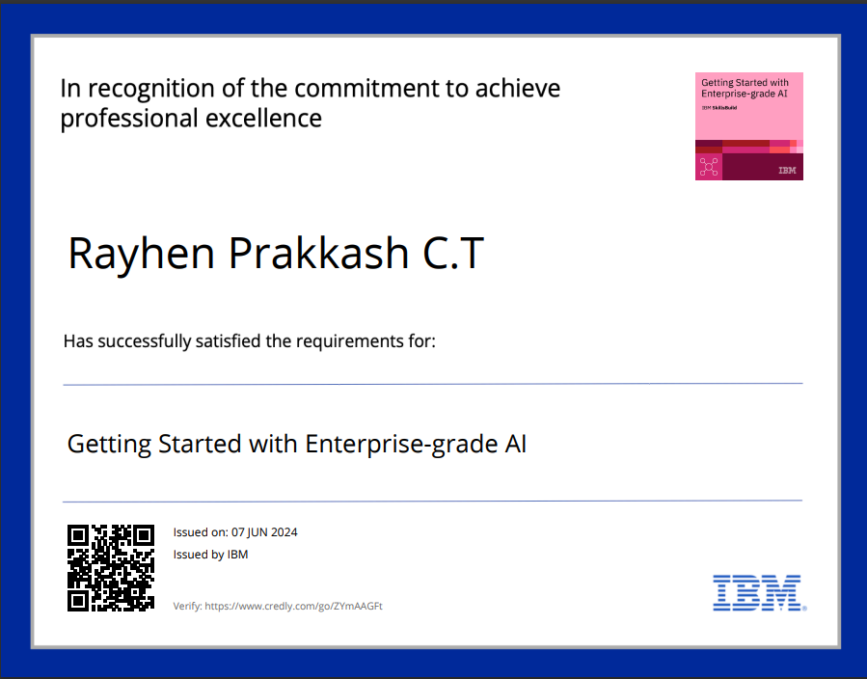
course certificate 1

Slide 12
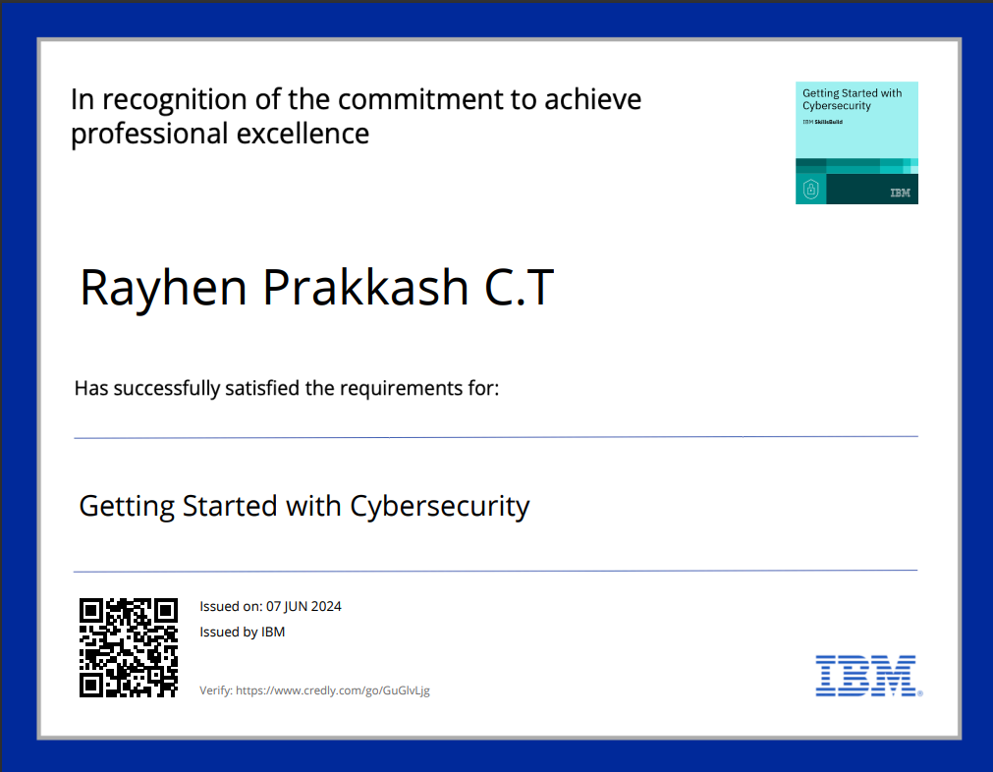
course certificate 2

Slide 13
THANK YOU

